Slide 1
Gale In Context: Literature
Notes:
Use this slide to introduce yourself and the presentation for Gale In Context: Literature, which provides information on commonly studied literature topics from a variety of sources, including select full text works of literature.
Notes throughout this presentation provide instruction around areas to customize for your specific audience, as well as speaker notes to make the process of presenting easier. Feel free to hide slides and select what content to feature if you are given shorter speaking times, or if you’re able to take attendees live into Gale In Context: Literature.

Slide 2
GALE IN CONTEXT: LITERATURE
A HOLISTIC APPROACH TO LEARNING LITERATURE
Secondary (9-12) leveled resource from basic to advanced learners
Full-text available for many titles
Topic browse and search consistent with other Gale In Context Resources
Fully integrated with Gale In Context: For Educators

Slide 3
GALE IN CONTEXT: LITERATURE
Provide Context
Students can explore the world surrounding the literature through:
Work Overviews
News and Magazines
Author Biographies
Images and Videos
Literature Criticism
Support Curriculum
Topics related to literary themes and devices, eras, and movements allow students to think critically about the writing process and key text pieces
Plot Diagrams and Character Maps allow students to better follow the text and see developing themes
Empower Learners
Research tools including Highlights and Notes, Topic Finder, Translations, and Google/Microsoft Integration allow for organized and effective research
Notes:
Gale In Context: Literature provides content aligned with national and state curriculum standards focused on key literary topics, themes, and works.
Students will have access to work overviews, literature criticisms, multimedia content, author biographies, and more.

Slide 4
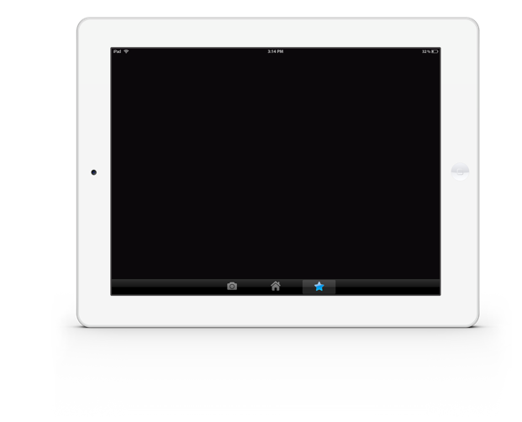
ACCESS
Anytime
Anywhere
Any Device
Without Ads or Paywalls
WWW.LIBRARYRESOURCESURL.EDU
Notes:
Customize the library access URL on this slide before presenting.
All of the content in Gale In Context: Literature can be accessed by you and your learners 24/7 on any device, no matter where you are. Your entire class can look at the same article at once without problems, and there are no limits to the amount of content you can access.
Additionally, Gale In Context: Literature is an ad-free environment that provides full-text access without paywalls.

Slide 5
INTEGRATE INTO YOUR LMS
Notes:
The next few slides cover discovery within Schoology and Canvas. If you are utilizing one of these LMS unhide these slides, if not you can keep them hidden during your presentation. Remember: integrating into your LMS means your users will automatically authenticate into Gale In Context: Literature when selected.

Slide 6
SCHOOLOGY
ACCESS THROUGH COURSE HOME
Your integrated Gale resources will appear in the tool bar on the left.
Notes:
To select a resource added to a course users will need to select the course and choose the correct resource from those added to the left side tool bar.

Slide 7
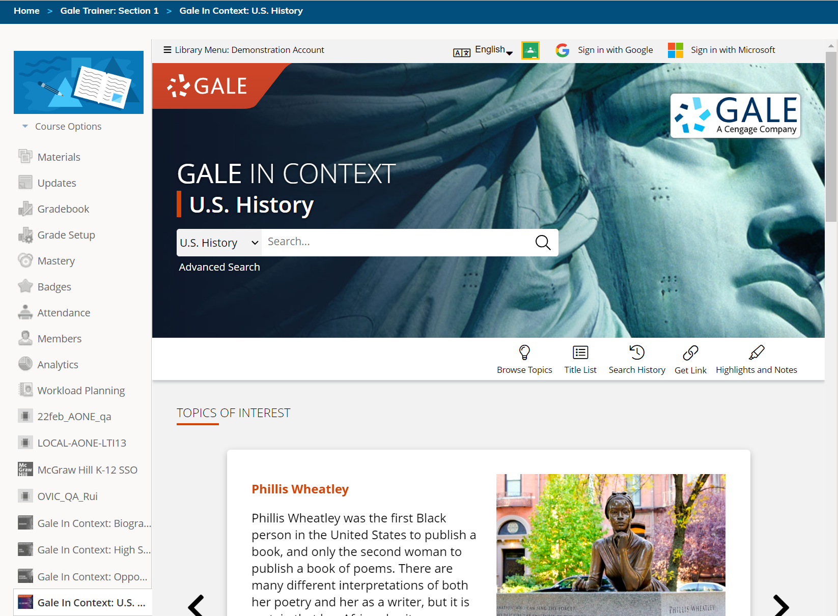
SCHOOLOGY
ACCESS THROUGH COURSE HOME
Your integrated Gale resources will appear in the tool bar on the left.
Selecting a resource will open it within the Schoology interface.
Notes:
To select a resource added to a course users will need to select the course and choose the correct resource from those added to the left side tool bar.
Selecting the Gale In Context: Literature option will launch them straight into the resource, while keeping them in the Schoology interface.

Slide 8
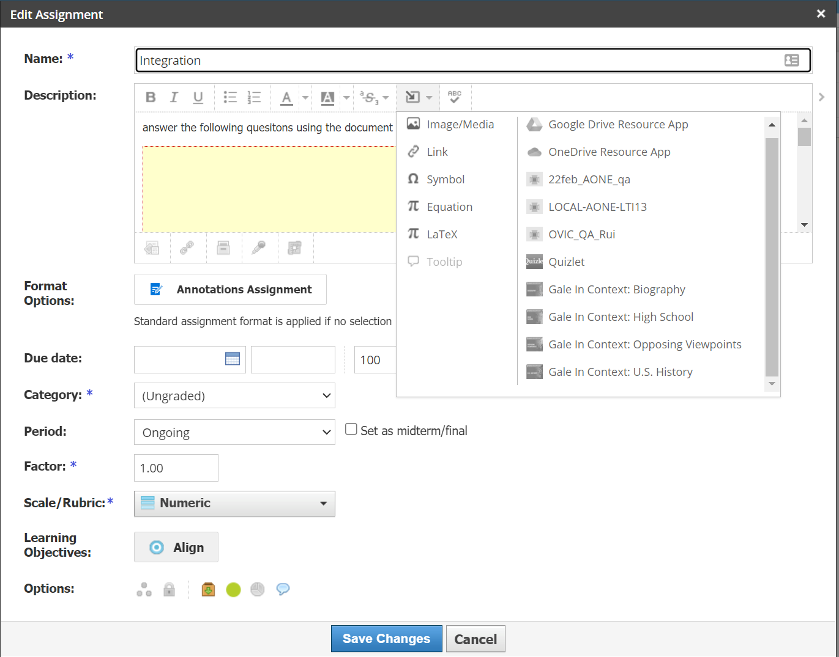
SCHOOLOGY
ACCESS THROUGH MATERIALS
When creating or editing a material, select the Insert Content drop down in the Description section and choose your resource.
Notes:
To access resources while creating or editing a material (like an assignment or discussion post) teachers will select the Insert Content option at the top of the description dialogue box. The drop down will have Gale In Context: Literature listed.

Slide 9
SCHOOLOGY
ACCESS THROUGH MATERIALS
When creating or editing a material, select the Insert Content drop down in the Description section and choose your resource.
The resource will open within Schoology. Utilize the Link to Document or Embed Document buttons to add content to your material.
Notes:
Selecting the Insert Content option pulls forward the Gale In Context: Literature interface while continuing to keep the user within Schoology.
While in Gale In Context: Literature users can choose either Link to Document or Embed Document. Selecting Link to Document will enter a URL into the material that others will be able to select. Embed Document creates an iframe in which the native Gale In Context: Literature platform is available.

Slide 10
CANVAS
ACCESS THROUGH COURSE HOME
Your integrated Gale resources will appear in the tool bar on the left.
Notes:
To select a resource added to a course users will need to select the course and choose the correct resource from those added to the left side tool bar.

Slide 11
CANVAS
ACCESS THROUGH COURSE HOME
Your integrated Gale resources will appear in the tool bar on the left.
Selecting a resource will open it within the Canvas interface.
Notes:
To select a resource added to a course users will need to select the course and choose the correct resource from those added to the left side tool bar.
Selecting the Gale In Context: Literature option will launch them straight into the resource, while keeping them in the Canvas interface.

Slide 12
CANVAS
ACCESS THROUGH MATERIALS
When creating or editing a material, select the Apps drop down in the Details section and choose your resource.
Notes:
To select a resource added to a course users will need to select the course and choose the correct resource from those added to the left side tool bar.
Selecting the Gale In Context: Literature option will launch them straight into the resource, while keeping them in the Canvas interface.

Slide 13
CANVAS
ACCESS THROUGH MATERIALS
When creating or editing a material, select the Apps drop down in the Details section and choose your resource.
The resource will open within Canvas. Utilize the Link to Document or Embed Document buttons to add content to your material.
Notes:
To access resources while creating or editing a material (like an assignment or discussion post) teachers will select the Apps option at the top of the Details dialogue box. The drop down will have Gale In Context: Literature listed.

Slide 14
DISCOVER PREMIUM RESOURCES

Slide 15
BROWSE OR SEARCH
EXPLORE CONTENT
VIEW AND SHARE RESULTS
Notes:
It’s easy to access all the premium resources within Gale In Context: Literature by browsing or searching for topics of interest including works, authors, themes and genres, exploring content organized by type, and then clicking individual result titles to view and use videos, documents, and more.

Slide 16
BROWSE
Browse all topics with Browse Topics button
OR
Scroll on the homepage for detailed topics
Notes:
Gale In Context: Literature is designed to make it easy for you and your students to browse for topics of interest. Click the Browse Topics option in the upper right corner of the homepage and on many other pages throughout Gale In Context: Literature to access a list of all topics for which there are curated pages, including works, authors, genres, themes, and other ELA topics.
When you click the title of one of the topics, you’ll be taken to a second level of organization in which you can select either a work of interest or an ELA topic of interest. These topics provide curated Topic Pages in which the content is organized for simple discovery.
Note that if you do not see a topic page related to something of interest, that just means that you can run a basic or advanced search within Gale In Context: Literature to view any available results (it doesn’t mean content on that topic is unavailable).

Slide 17
SEARCH
Enter simple search terms
Notes:
To perform a basic search, just enter key terms related to topics of interest in the search box on the homepage or at the top of every page throughout Gale In Context: Literature.

Slide 18
SEARCH
Enter simple search terms
Or, customize multiple fields and limiters
Notes:
You can also run a more targeted or customized search by clicking the Advanced Search option beneath or to the side of the basic search box. Advanced Search provides the option to select specific search fields and combine these fields/terms in various ways (for instance using NOT if you want articles about one subject but are NOT interested in any articles that also focus on a related subject that is not relevant to what you are teaching). If you scroll down the page, you can also include search options to limit results by document type, date, content level, and more.

Slide 19
EXPLORE AND FILTER RESULTS
Examine Content Types
Click to focus on results within a format of interest
Notes:
Once you run a search or click a content type header on a topic page, you’ll find options to further pinpoint results of interest. At the top of the page, you can click to view results of specific types (reference, plot summaries, literature criticisms, primary sources, etc.) depending on what’s available for your search.

Slide 20
EXPLORE AND FILTER RESULTS
Examine Content Types
Click to focus on results within a format of interest
Narrow Results
Limit by Publication Date, Subjects, Document Type, etc.
Notes:
In the Filter Your Results portion on the right-hand side of the results, you’ll find options to limit your search results further based on publication date, subjects, content level, etc. Simply click one of the filtering options, check the box next to specific filters of interest, and then click to Apply the filter.

Slide 21
EXPLORE AND FILTER RESULTS
Examine Content Types
Click to focus on results within a format of interest
Narrow Results
Limit by Publication Date, Subjects, Document Type, etc.
View Individual Sources
Access items of interest
Notes:
When you find an item that you’d like to view, simply click the title of the result to access the document, video, image, etc. From there, you’ll find an array of tools that you can use to incorporate the content into your lessons and assignments. We’ll cover these tools and strategies a bit later.

Slide 22
UTILIZE TOPIC PAGES: WORKS PAGES
Work Overview:
Within the banner students will find a small blurb about the work, as well as a link to the full Overview.
Full Text and Video:
If a full text is available, students will see the Read Book button under the cover image.
Every Topic Page also includes a short video related either to the title itself or related themes.
Essential Questions:
Critical thinking questions are available under the banner to engage students in their learning.
Author Information:
Basic author facts as well as a link to more detailed biographical information are listed under the banner.
Content:
Content buckets with all related materials are at the bottom of the page.
Notes:
The most searched, studied, and utilized works within Gale In Context: Literature have been developed into Topic Pages. Each of these pages organize basic information about the work and its author, provide context and critical thinking questions, and organize the related content into buckets like Plot Summaries, Images, Primary Sources, and more. Note: If a student is looking for a work without a Topic Page, they will be able to find content by running either a Basic or Advanced Search.

Slide 23
UTILIZE TOPIC PAGES: AUTHOR PAGES
Author Overview:
Within the banner students will find basic information about the individual and a link to a full article.
Video:
Like work pages, students can access a short video related to the author.
Quick facts give basic demographic information for additional context.
Related Topics:
This section directs students to related topics including works, themes, genres, and other authors.
Quick Facts:
Quick facts give basic demographic information for additional context.
Content:
Content buckets with all related materials are at the bottom of the page.
Notes:
The most searched, studied, and utilized authors within Gale In Context: Literature have been developed into Topic Pages as well. These have the same general formatting as Work Topic Pages, but highlight key information about the author, as opposed to their works.

Slide 24
UTILIZE TOPIC PAGES: MOVEMENTS, GENRES, ERAS, THEMES, ELA
Overview:
A one paragraph overview is included at the top of the page.
Result Categories:
This section provides students with details about what types of materials are available.
Content:
Content buckets with all related materials are at the bottom of the page.
Notes:
If your staff is familiar with other Gale In Context resources, they will notice this layout is identical to those found in the other resources. Students will find a full paragraph overview and then be prompted to select an article to learn more. The content is still organized into different buckets to help students quickly see what’s available, and related topics are listed at the bottom of the page.

Slide 25
EXPLORE CONTENT
OVERVIEWS
PLOT SUMMARIES
LITERATURE CRITICISMS
MULTIMEDIA
BIOGRAPHIES
NEWS
AND MORE
FULL- TEXT ENTRIES
PRIMARY SOURCES
INFOGRAPHICS
Notes:
Depending on the topic you search or browse, you will find a wide variety of content types.

Slide 26
OVERVIEWS
Detailed information about works and their authors
Introduce works or topics
Develop background knowledge
PLOT SUMMARIES
Gain a basic understanding of the text
Review information like characters, themes, and settings
Assist in lesson review
CRITICISMS
Hear what the experts think
Explore differing opinions
Develop opinions based on expert arguments
Notes:
Many text entries support both a basic and more advanced understanding of works, genres, themes, and ELA topics. Many provide additional context to help student better understand the setting in which works were written. These materials can support lesson or unit introductions, reading supplementation, or end of unit reviews.

Slide 27
FULL-TEXT ENTRIES
Select titles allow students to read full works while within Gale In Context: Literature
Notes:
Full-text entries are available for select titles within Gale In Context: Literature. Access to a full-text work is found on that work’s topic page. A Read Book button will appear under the cover image within the topic page banner. Full texts open in a new window and allow students to click through pages.

Slide 28
INFOGRAPHICS
Interactive character maps and plot diagrams guide students through difficult texts
Notes:
Character maps and plot diagrams are found within their own content bucket called Infographics. Students can interact with the charts and diagrams to better understand the text from start to finish. Students may benefit from keeping a character map open as they read to remind them who is who.

Slide 29
PRIMARY SOURCES
Primary Sources including speeches, plays, and memoirs engage students in the historical context surrounding works, movements, and themes
Notes:
Many primary sources include introductions to the text to orient students to what they are about to read.

Slide 30
MULTIMEDIA
Images, audio file, and videos provide additional support for struggling readers
BIOGRAPHIES
Gain a deeper understanding of the authors behind the works being studied
NEWS AND MAGAZINES
Link current events to lessons, understand how society impacts literature and visa versa
Notes:
Supporting content within Gale In Context: Literature is diverse and extensive. Students will find a variety of content types to support every aspect of their learning.

Slide 31
SUPPORT DEVELOPING AND ADVANCED LEARNERS
LOWER ELEMENTARY
Up to 500L
UPPER ELEMENTARY
501L – 850L
MIDDLE SCHOOL
851L – 1100L
HIGH SCHOOL
1101L – 1300L
UNDERGRADUATE AND UP
1301L +
Notes:
Gale In Context: Literature contains leveled content, so if you support developing readers, or advanced students, you can find content targeted to their needs! These content levels can be viewed on search and browse results pages. As Gale In Context: Literature is a secondary-focused resource, the majority of the content will be in the levels 3-5.

Slide 32
ENHANCE LEARNING
Notes:
All of the content within Gale In Context: Literature can not only be accessed anywhere 24/7 on any device with an internet connection with no limits to the number of students who can view the same article at the same time, but also provides helpful tools to transform the premium content found within into resources to support learning and the development of research skills.

Slide 33
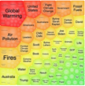
SHARE CONTENT
Get Link, Share to Classroom, Send to…
Push premium results to students and facilitate collaboration
SUPPORT ACCESSIBLE LEARNING
Translate, Text Manipulation, Listen
Provide options for learners with varied needs and preferences
ENCOURAGE ANALYSIS
Highlights and Notes
Promote deeper learning with color-coding and annotation
DEVELOP RESEARCH SKILLS
Topic Finder, Cite
Advance ability to define topics and use sources responsibly
Notes:
These tools include options to easily push content to students, or have students share with you/with each other, features to make content accessible to learners with a variety of needs, the highlights and notes tool that can be used in many different ways to record student analysis of sources for assignments or research, and tools to help scaffold the research process-– from choosing and refining a topic to citing the information appropriately.

Slide 34
SHARE CONTENT
Google Classroom Integration
Get Link
Email, Send to Drive, Print, Download
Notes:
Every item within the resource provides options to export or share the content for later use. Get Link creates a persistent URL that will direct someone right back to the page you were on when you used the Get Link tool. Share to Classroom allows you to pull content into Google Classroom courses as assignments, announcements, and more. The Send to… feature and quick links give you the ability to push content to an email address, Google Drive, or Microsoft OneDrive account for viewing at any time in the future (content does not expire from these tools until you decide to delete/remove it). There are no limits to the number of times you can use these features, and you can also download and print content.

Slide 35
SHARE CONTENT
GET LINK
Copy and paste persistent URL to websites, LMS, assignments, etc.
Notes:
Push content to students by clicking Get Link to create a persistent URL that you can copy and paste anywhere.

Slide 36
SHARE CONTENT
GOOGLE CLASSROOM
Follow Google Classroom prompts to create assignments, announcements, and more
Notes:
Click the Share to Classroom button in the upper right portion of the screen. If you’re not already signed in to your Google Classroom account, you will be asked to do so.
From there, follow the Google prompts in the pop-up screen to decide which course you’d like to share the content to, and how.

Slide 37
SHARE CONTENT
SEND TO…
Email or Export Results to Google Drive or Microsoft OneDrive
Notes:
Every result can be emailed or sent to Google Drive or Microsoft OneDrive for viewing whenever/as long as you want (all documents can also be printed or downloaded if you prefer). You can click any of the shortcuts to email, Google Drive, or Microsoft OneDrive at the top of an item’s text, or use click Send to… in the upper righthand corner to start the process and follow on-screen prompts.

Slide 38
SUPPORT ACCESSIBLE LEARNING
TRANSLATE
Machine translate articles to 50 languages
Notes:
Users can translate the platform (which include all navigation, buttons, and the search bar), or can translate the text of the entry only.

Slide 39
SUPPORT ACCESSIBLE LEARNING
TRANSLATE
Machine translate articles to 50 languages
FONT SIZE
Increase or reduce as needed
Notes:
Increase or decrease the font size as needed.

Slide 40
SUPPORT ACCESSIBLE LEARNING
TRANSLATE
Machine translate articles to 50 languages
FONT SIZE
Increase or reduce as needed
DISPLAY OPTIONS
Edit the font style, color, and spacing
Notes:
Change the font, text and background color, and line, letter, and word spacing to enhance readability.

Slide 41
SUPPORT ACCESSIBLE LEARNING
TRANSLATE
Machine translate articles to 50 languages
FONT SIZE
Increase or reduce as needed
DISPLAY OPTIONS
Edit the font style, color, and spacing
LISTEN
Hear text read aloud, and download as an MP3
Notes:
Listen to the article with settings to highlight words and sentences being read, change the speed, and enhance the visibility.

Slide 42
ENCOURAGE ANALYSIS: HIGHLIGHTS AND NOTES
STEP 1
SELECT TEXT
Click and drag mouse on computer;
Tap on tablet or mobile device
ADD HIGHLIGHTS AND NOTES
Choose color and type annotations in pop-up menu
STEP 2
EXPORT
Add as many notes as desired Download, Print, or Send to… Email, Google Drive or OneDrive before closing
STEP 3
Notes:
In addition to the sharing features we just discussed, all text results include the option to add highlights and notes. You can use these features to call out specific portions of text or to note questions for students; or you can ask students to color code specific items (pro or con arguments, first read/second passes in close reading assignments, strong points made within and questions about a text. Etc.), add their thoughts, send the document to Google Drive or OneDrive (or download it), and then share the Google Doc, Microsoft Word Online doc, or PDF with you for further commentary.

Slide 43
DEVELOP RESEARCH SKILLS: TOPIC FINDER
TOPIC FINDER
Visually Map Search Results
Interact to narrow topics step by step
Notes:
When students have a topic in mind and begin searching the resource, topic finder provides a visual tool for them to better understand the divisions and connections within their larger topics in order to begin defining a more narrow, unique research direction.

Slide 44
DEVELOP RESEARCH SKILLS: TOPIC FINDER
TOPIC FINDER
Visually Map Search Results
Interact to narrow topics step by step
STEP ONE
Run a Basic Search
Notes:
Topic finder can be accessed after running a search within the Gale In Context: Literature.

Slide 45
DEVELOP RESEARCH SKILLS: TOPIC FINDER
TOPIC FINDER
Visually Map Search Results
Interact to narrow topics step by step
STEP ONE
Run a Basic Search
STEP TWO
Start the Topic Finder
Notes:
On the right-hand side of the page, under the filters, click Start the Topic Finder.

Slide 46
DEVELOP RESEARCH SKILLS: TOPIC FINDER
TOPIC FINDER
Visually Map Search Results
Interact to narrow topics step by step
STEP ONE
Run a Basic Search
STEP TWO
Start the Topic Finder
STEP THREE
Click to explore sections and link to results
Notes:
You or your students can then interact with either a tile (shown in this screenshot) or wheel visualization that maps out and breaks down major themes within the larger topic. Click to interact with the tiles or wheels.

Slide 47
DEVELOP RESEARCH SKILLS: CITATION
CITE
Access a citation for every piece of content found within the resource.
CITE BUTTON
Select Citation in the tool bar
ON-PAGE CITATION
Scroll to the bottom of the page
Notes:
A seamless Cite tool is built into every item within the Gale In Context: Literature to ensure that students have support in using and citing resources responsibly.
Click Cite to provide machine-generated MLA, APA (7th edition is now available within the tool), and/or Chicago style citations. Use the Select button to select, then copy and paste the citation into a document, or Export the citation to services like EasyBib and NoodleTools.

Slide 48
?
…
Notes:
Use this slide as a visual prompt for final questions and/or discussions

Slide 49
DEVELOP RESEARCH SKILLS: CITATION
EXPLORE Gale In Context: Literature
SHARE WITH STUDENTS
CONTACT THE LIBRARY!
Notes:
Wrap up– ask teachers to visit the resource, share articles with students, and contact the library for support

Slide 50
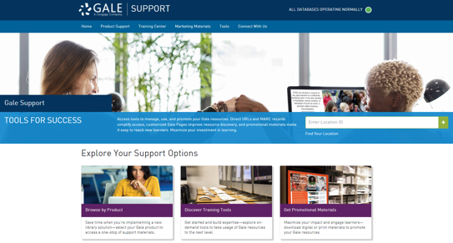
CONNECT FOR MORE IDEAS
ENTER LIBRARIAN NAME
emailaddress@school.edu
LIBRARY WEBSITE
www.librarysite.edu
SUPPORT.GALE.COM/TRAINING
Lesson plans, tutorials, scavenger hunts, and more
Notes:
Customize this concluding slide with your contact and site/access information.

